Slide 1


Export management system
Zaheer Khan

Slide 2


INTRODUCTION
An export management system or software is a tool that helps you manage and automate your export processes, such as screening customers and suppliers, classifying products, generating and filing export documents, tracking shipments, and reporting and auditing export activities.

Slide 3
ER DIAGRAM

Slide 4
ER DIAGRAM
Importer_detail
No (PK)
Product_name (MK)
Distributer_name
Quantity
Price
Distributor_detail
No (PK)
Product_name (MK)
Importer_Company
Quantity
Price
Product_detail
No
Product_name (PK)
Importer_name
Quantity
Price
Transaction_detail
No (PK)
Product_name (MK)
importer-_Company
Quantity
Amount
Date
Inquiry_detail
No (PK)
Importer_Company
Inquiry
Response_given
Date

Slide 5
DATABASE DESIGN
DATABASE : Export_Management_System
TABLES :
Product_detail
Importer_detail
Distributor_detail
Transaction_detail
Inquiry_detail

Slide 6
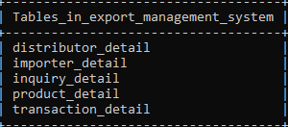
SYNTAX : SHOW TABLES;

Slide 7
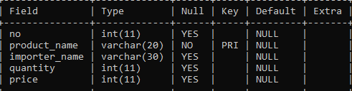
Suppose I want to see the structure of table
SYNTAX : DESC PRODUCT_DETAIL;
Desc is the build-in function of sql use to see structure of tables

Slide 8
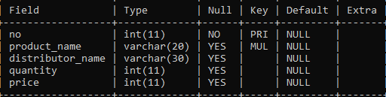
SYNTAX : DESC IMPORTER_DETAIL;

Slide 9
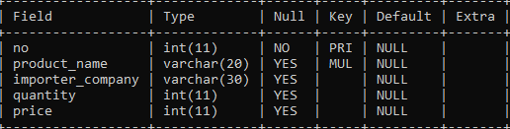
SYNTAX : DESC DISTRIBUTOR_DETAIL;

Slide 10
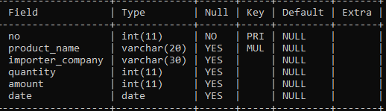
SYNTAX : DESC TRANSACTION_DETAIL;

Slide 11
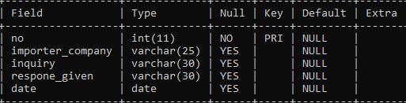
SYNATX : DESC INQUIRY_DETAIL;

Slide 12
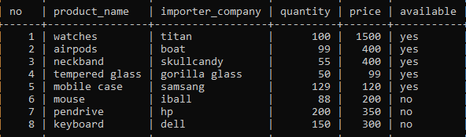
Suppose I want to see details of product_detail table
SYNTAX : SELECT * FROM PRODUCT_DETAIL;
Select is a clause used to fetch data from a table

Slide 13

Suppose I want to see details of importer_detail table
SYNTAX : SELECT * FROM IMPORTER_DETAIL;

Slide 14
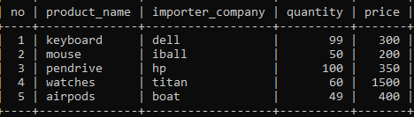
Suppose I want to see details of distributor_detail table
SYNTAX : SELECT * FROM DISTRIBUTOR_DETAIL;

Slide 15
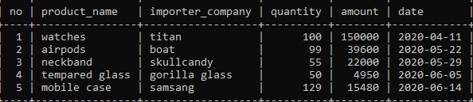
Suppose I want to see details of transaction_detail table
SYNTAX : SELECT * FROM TRANSACTION_DETAIL;

Slide 16
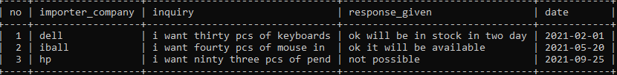
Suppose I want to see details of inquiry_detail table
SYNTAX : SELECT * FROM INQUIRY_DETAIL;

Slide 17
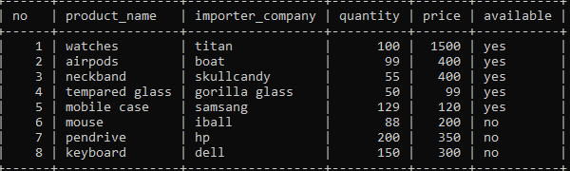
Suppose I want change my data in the table
SYNTAX : UPDATE PRODUCT_DETAIL SET IMPORTER_DETAIL=‘CASIO’ WHERE NO=1;
UPDATE is a clause used to modify existing records in a database table
PREVIOUS TABLE

Slide 18

AFTER USING UPDATE CLAUSE

Slide 19
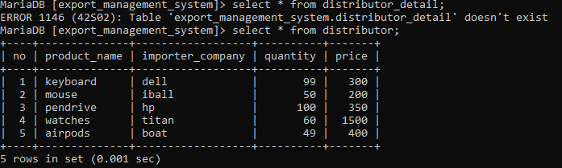
Suppose I want to change the name of the table
SYNTAX : ALTER TABLE DISTRIBUTOR_DETAIL RENAME DISTRIBUTOR ;
ALTER is a keyword used to modify the structure of an existing database object, such as a table, view, or index .

Slide 20
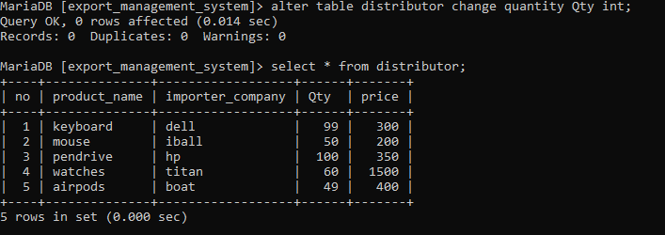
SYNTAX : ALTER TABLE DISTRIBUTOR CHANGE QUANTITY QTY INT;

Slide 21
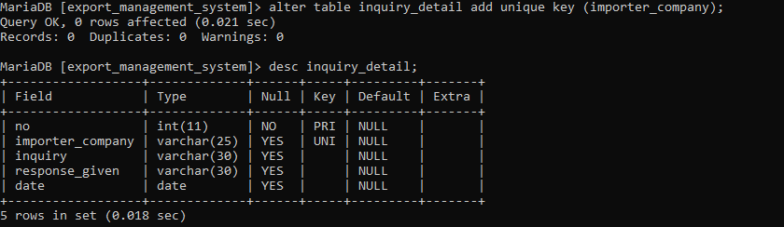
Suppose I want to add unique key in the column
SYNTAX : ALTER TABLE INQUIRY_DETAILS ADD UNIQUE KEY (IMPORTER_COMPANY);
UNIQUE constraint or UNIQUE key is a type of constraint used to enforce uniqueness on the values of one or more columns in a table

Slide 22
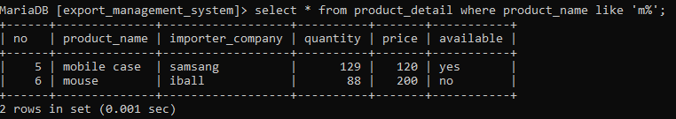
Suppose I want some specified data from the table
SYNTAX : SELECT * FROM PRODUCT_DETAILS WHERE PRODUCT_NAME LIKE ‘R%’ ;
LIKE operator is used in the WHERE clause of a query to perform pattern matching on a column's values. It allows you to search for rows in a table that match a specific pattern or substring

Slide 23
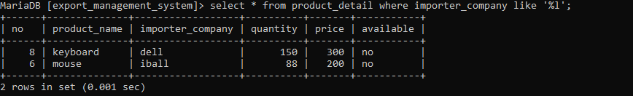
SYNTAX : SELECT * FROM PRODUCT_DETAILS WHERE IMPORTER_COMPANY LIKE ‘%l’ ;

Slide 24
Suppose I want to hide some column
SYNTAX : CREATE VIEW PRODUCT_DETAILS AS SELECT PRODUCT_NAME,COLOR,PRICE FROM PRODUCT;
VIEW is a virtual table derived from the result of a SELECT query. It allows you to encapsulate complex queries into a single, reusable object that can be referenced in other queries or applications. A VIEW does not store any data itself; instead, it provides a logical representation of the data from one or more underlying tables or other views.
PREVIOUS TABLE

Slide 25
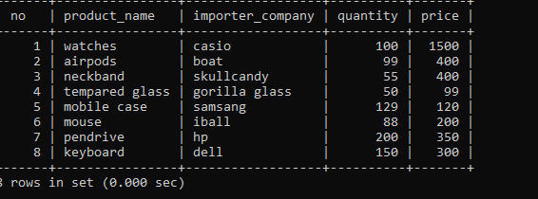
AFTER CREATEING VIEW TABLE

Slide 26
Suppose I want to fetch the data of first 3 products
SYNTAX : SELECT * FROM DISTRIBUTOR LIMIT 3 ;
LIMIT clause is used to restrict the number of rows returned by a SELECT query. It is particularly useful when you want to retrieve only a specific number of rows from a result set, especially when dealing with large datasets
PREVIOUS TABLE

Slide 27
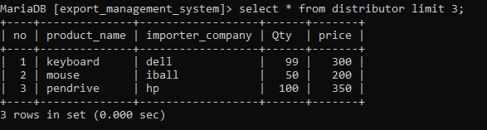
AFTER USING LIMIT IN DISTRIBUTION TABLE

Slide 28
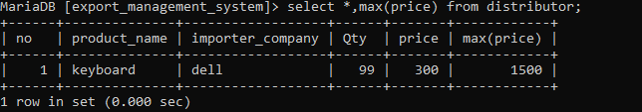
Suppose I want to perfoms a calculation on multiple values and returns a single value.
SYNTAX : SELECT *,MAX(PRICE) FROM DISTRIBUTION;

Slide 29
Suppose I want to see the data of distributor and transaction_detail table
SYNTAX : SELECT * FROM DISTRIBUTOR LEFT TRANSACTION_DETAIL ON DISTRIBUTOR.NO = TRANSACTION_DETAIL. NO;
join is a powerful operation that allows you to combine rows from two or more tables based on a related column between them. Joins are used to retrieve data from multiple tables in a single query, enabling you to combine and analyze information that's spread across different tables in a database.
USING LEFT JOIN HERE

Slide 30
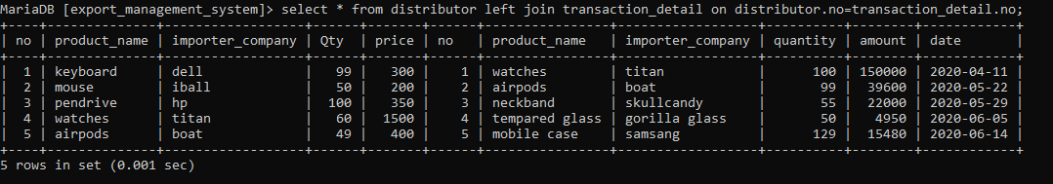
AFTER USING LEFT JOIN

Slide 31
Suppose I want to see the data of distributor and transaction_detail table
SYNTAX : SELECT * FROM DISTRIBUTOR INNER JOIN TRANSACTION_DETAIL ON DISTRIBUTOR.NO = TRANSACTION_DETAIL. NO;
INNER JOIN is a type of join operation in SQL that retrieves only the rows from both tables that have matching values in the specified columns. In other words, an INNER JOIN returns the intersection of the two tables, where the joined column's values match.
USING INNER JOIN HERE

Slide 32
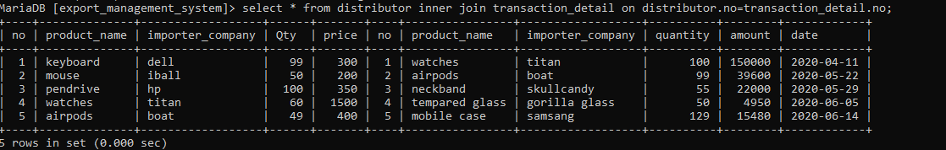
AFTER USING INNER JOIN

Slide 33
CONCLUSION
Through this project, I have gained hands-on experience in SQL database design, query optimization, and data manipulation. I have learned how to structure and manage complex data relationships, ensuring data integrity and security. This project has not only improved my technical skills but also provided a practical understanding of how databases facilitate seamless user experiences, efficient transactions, and insightful business analytics in the realm of online shopping

